Slide 1
Connected by Technology
Conversation

Slide 2


Lesson Objectives
The students will be able to :
1 – Predict the topic of a conversation .
2 – Understand the conversation .
3 – Use some texting abbreviation & Acronym in a text message .
4 – Use the "real talk" phrases in a conversation .
5 – Ask for clarifications in a conversation .

Slide 3

Is texting a common means of communication ?
texting

Slide 4


WHAT ?
texting
abbreviation

Slide 5

How do people text in your language?
e.g.

Slide 6

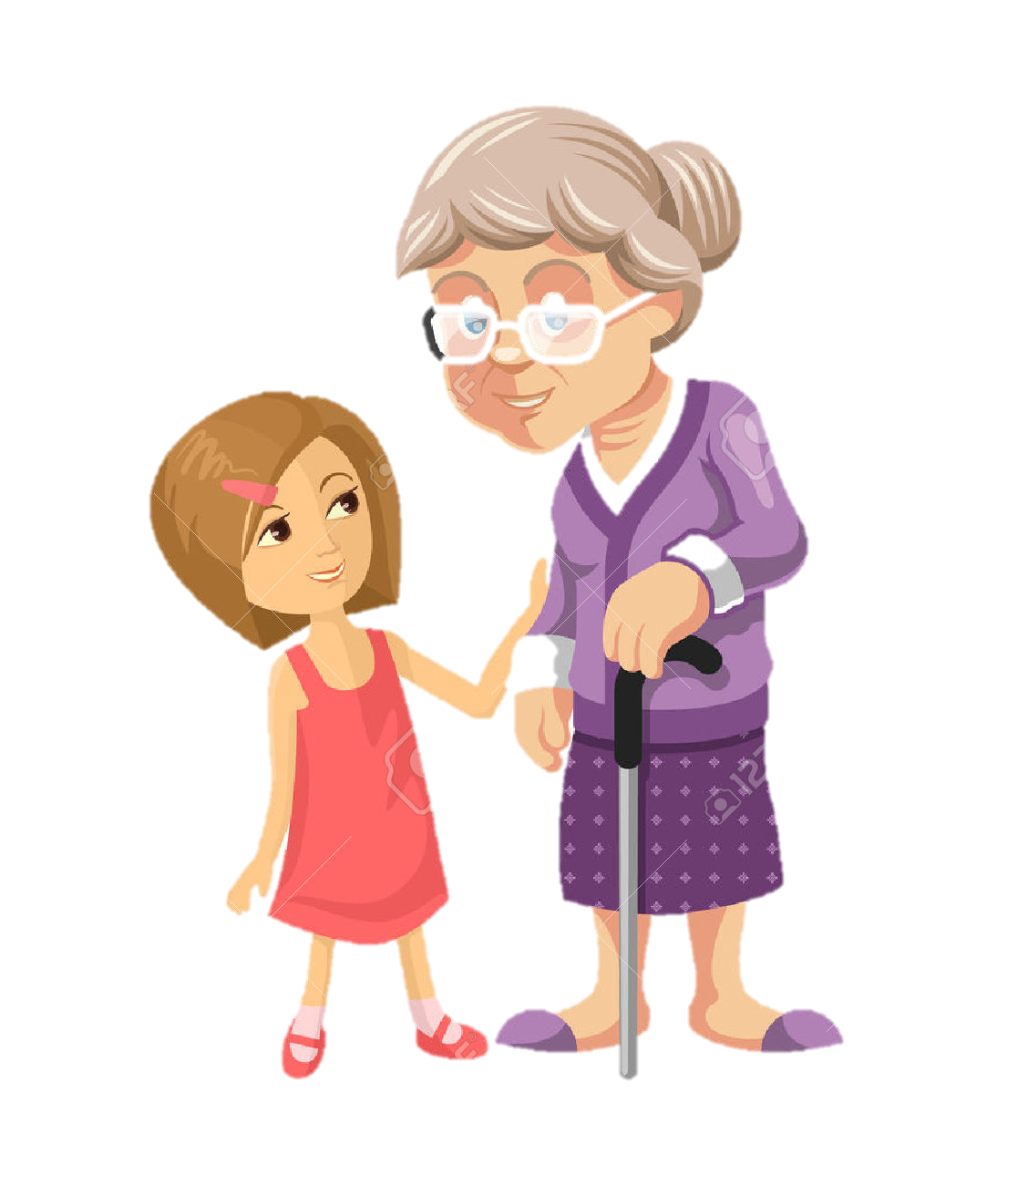
Listen to the audio
What do you think they are talking about ?
football?
….?

Slide 7
Listen to the audio
What are they talking about ?
What is the granddaughter’s name ?
What is Cara’s friend name ?
What is Cara doing ?
What is the sound grandma heard first ?
Does grandma know how to text ?

Slide 8
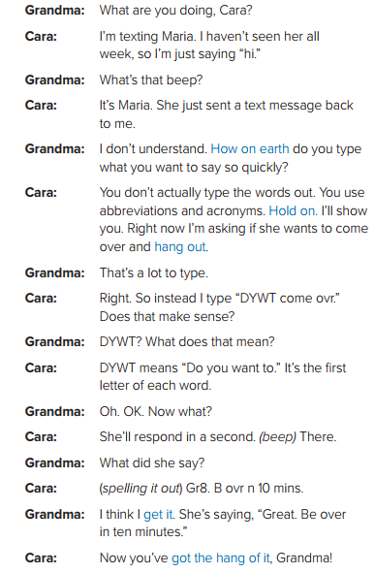

Listen ‘N’ read

Slide 9

Role-Play Time

Slide 10




Language Builder
abbreviation
acronym
a short form of a word
PLZ = please
ovr = over.
Gr8 = great
B4 = before
first letters of several words to write a phrase.
OMG = Ohh my God
DYWT = Do you want to.
WU? = What’s up?
B4N = bye for now

Slide 12
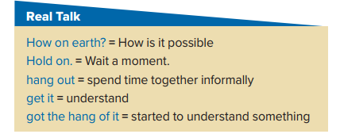
How on earth did that happen ?
If you can hold on , I’ll go and get some help .
Where do the youngsters hang out ?
I don’t get it – it doesn’t make sense .
I’ll teach you how to use the program – you’ll get the hang of it after a while.

Slide 13

Real Talk (phrases)
Practice Time
How on earth can you _____?
My friends and I often hang out at ______.
Hold on a minute. I have to _____.
I don’t get it. Why do you _____?
I finally got the hang of ______.

Slide 14
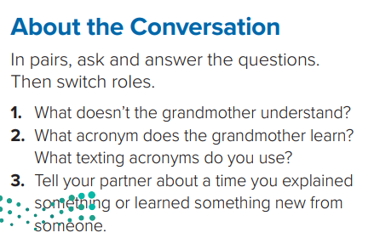
1- The grandmother doesn’t understand how Cara types a text message so quickly .
2- The grandmother learns the acronym, “DYWT,” or “do you want to.”

Slide 15
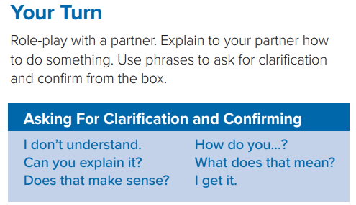


Which things would you say when you don’t understand something or want an explanation ?

Slide 16

What do you say when you understand something ?

Slide 17

What do you say when you want to know if your explanation is clear ?

Slide 18

Practice Time
U practice
Create conversations using
phrases from Real Talk
phrases for asking for clarification & confirming
phrases from Real Talk
phrases for asking for clarification & confirming

Slide 19
Choose the suitable phrase
hold on
Hi Ali. Let's ...... in the mall.
Hang out
Hi Ahmed. OK. I'll call Faris to meet us there.
How on earth?

Slide 20
Choose the suitable phrase
He will send you his place with google map.
get it
getting the long of it
Yes, I ...............
hold on

Slide 21
Choose the suitable phrase
Does that make sense..
............. google maps to me, please?
How on earth ..
Sure
Can you explain..

Slide 22

Put the conversation in the correct order
Just drag & drop from your files first
Great
How do you add a picture to Photoshop?
2
1
Ahaa, I get it now
4
3

Slide 23
Thank you!
You have a wonderful day

